Slide 2




Machine Learning for Microstructural Characterization of Archeological Specimens from XRT
Daniela Ushizima^{a,b}, Ke Xu^{c}, Matthew McCormick^{d}, Dula Parkinson^{e}, Paulo Monteiro^{c,f}
a Computational Research Division, Lawrence Berkeley National Laboratory, Berkeley, CA 94117, USA b Berkeley Institute for Data Science, University of California Berkeley, Berkeley, CA 94117, USA c Civil and Environmental Engineering, University of California Berkeley, Berkeley, CA 94117, USA
d Kitware Inc., Carrboro, NC 27510, USA e Advanced Light Source, Lawrence Berkeley National Laboratory, Berkeley, CA 94117, USA
f Materials Science Division, Lawrence Berkeley National Laboratory, Berkeley, CA 94117, USA

Slide 3
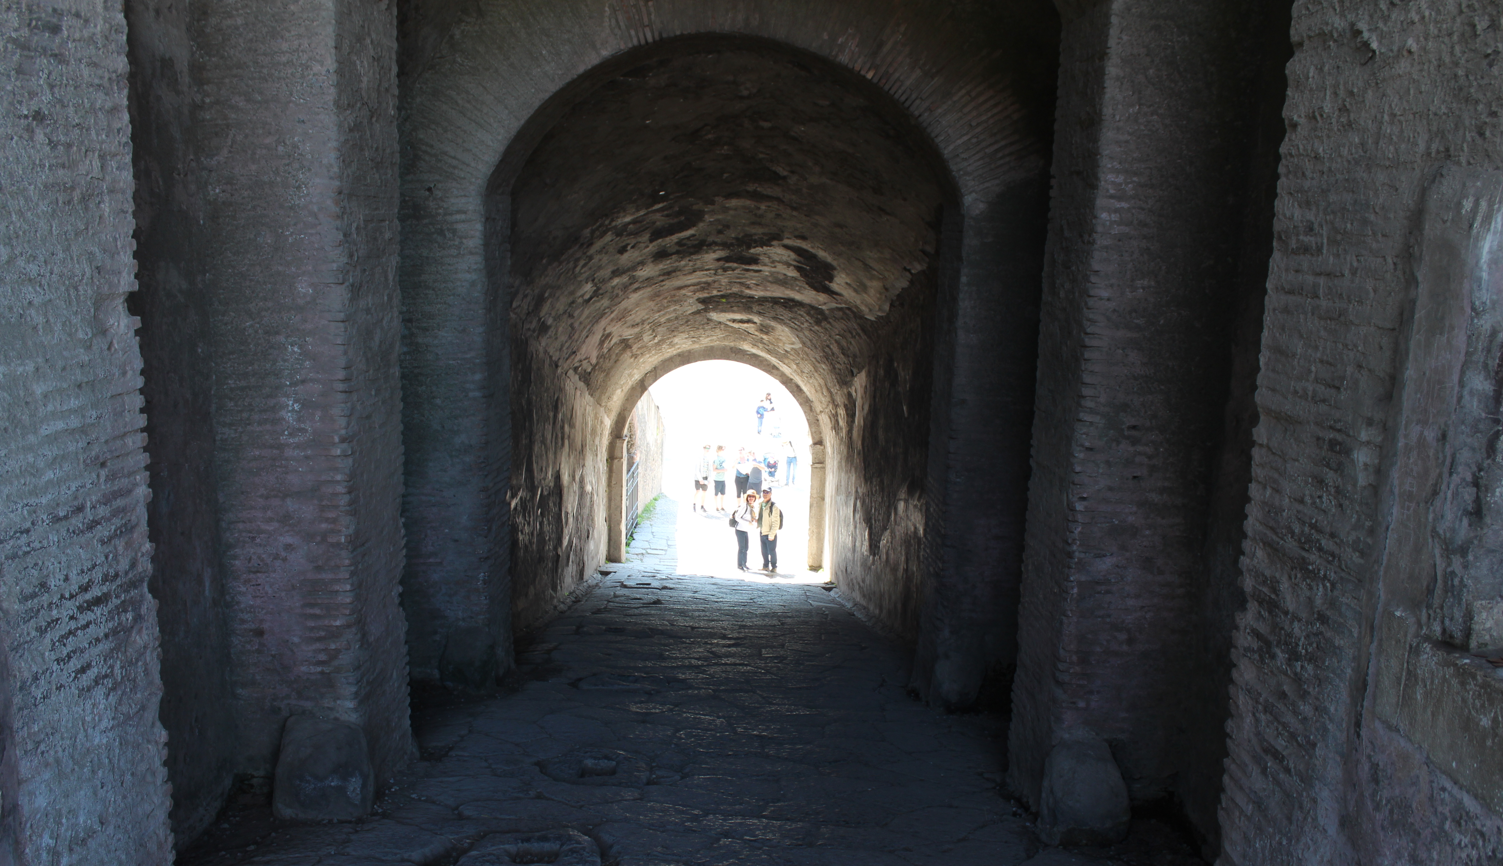
Ancient Roman Concrete - Pompeii

Slide 4
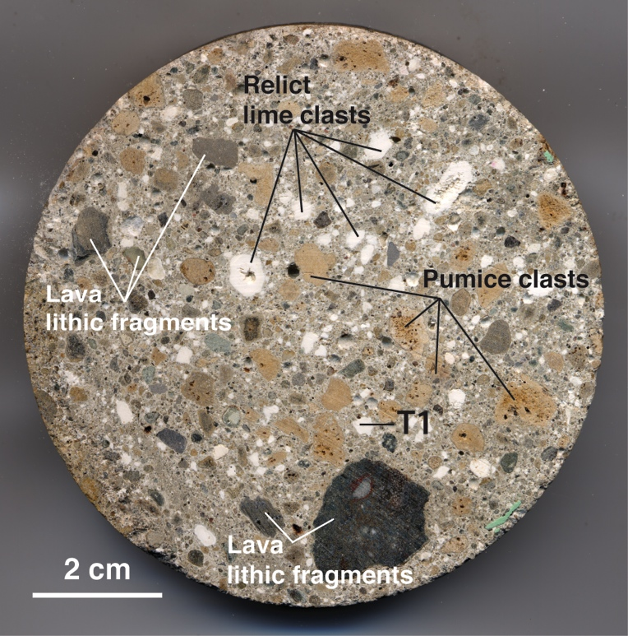
Jackson et al., American Mineralogist, Volume 98, pages 1669–1687, 2013

Slide 5


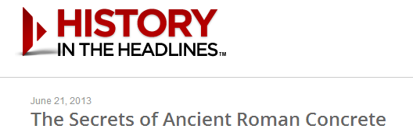
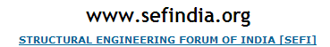
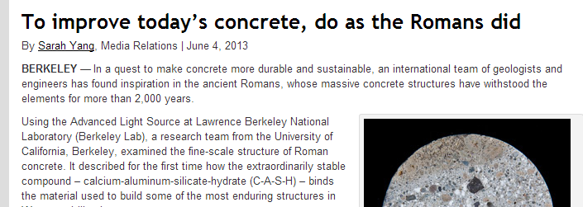

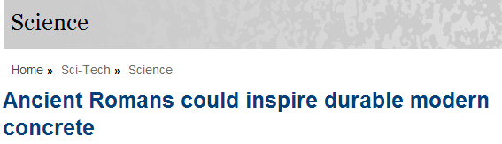
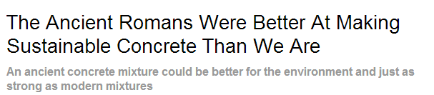
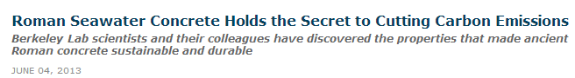
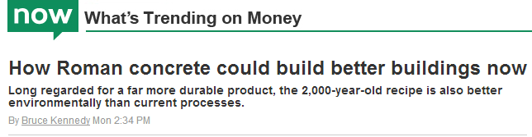
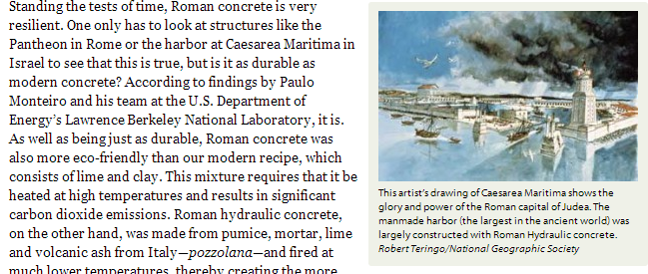



Notes:
Rome was not built in one day but it was built to last. Here are some articles that highlight how remarkable ancient Roman concrete is

Slide 6
Concrete industry faces tough challenges because of its large carbon footprint.

Slide 7
World demand/year
Concrete: 33 billion ton
Water: 2.7 billion ton
Aggregate: 27 billion ton
Cement: 3.7 billion ton
Mehta & Monteiro, fourth edition, 2014

Slide 8
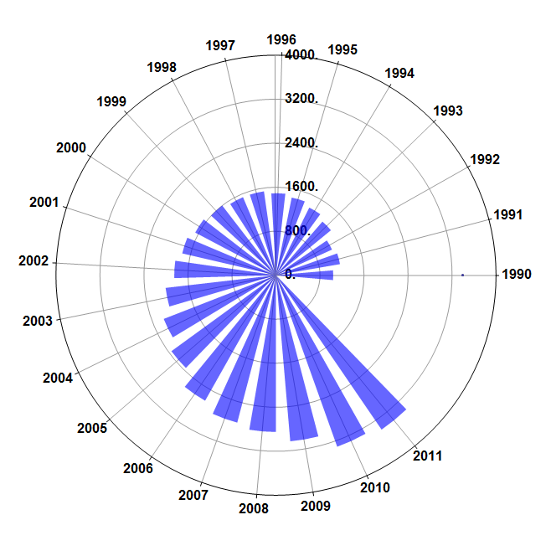
Recent Portland cement production
Courtesy: prof. Paulo Monteiro
million metric tons of cement
Notes:
From 800 to 4,000 in 20 years

Slide 9
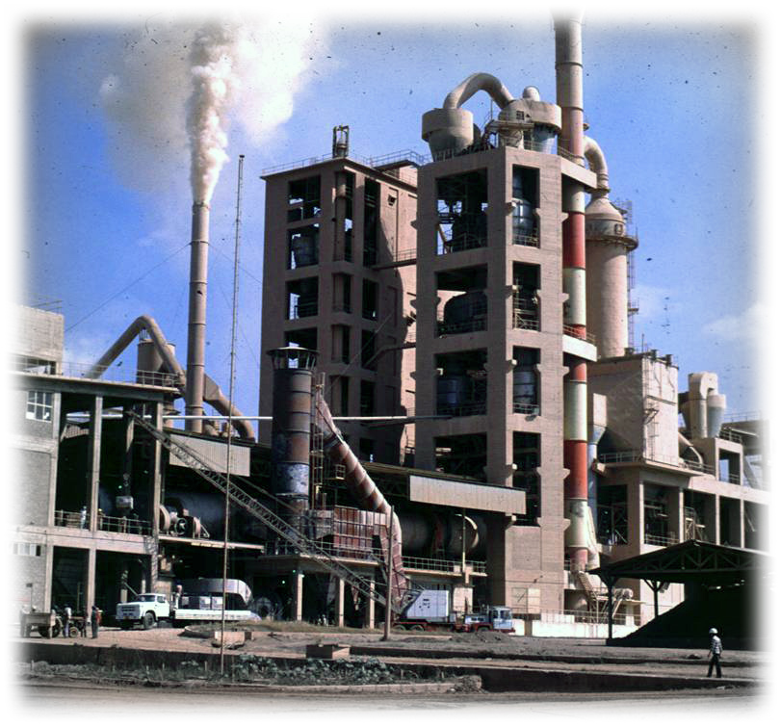
Environmental Impact
Cement industry generates 3 billion ton of CO₂
Portland cement: 1866 Coplay Cement Company;
Microstructure = crack resistance.
Courtesy: prof. Paulo Monteiro
Notes:
Production of cement is responsible for 7% CO₂ production in the world.
microstructures of concrete improves the crack resistance
Development of Portland Cement in the United States
In the spring of 1866, David O. Saylor, Esias Rehrig, and Adam Woolever started the Coplay Cement Company. The Coplay Cement Company was located along the west side of the Lehigh River and along side of the Lehigh Valley Railroad (L.V.R.R). Early in the 1870’s, Sailor began to experiment with the manufacturing of portland cement from rocks from his own quarry. With this experimentation, Saylor discovered the possibility of making portland cement from raw materials at his disposal. He noticed that the harder burned portions of his Rosendale clinker produced cement that would show a tensile strength equal to that of the best imported portland cement, for a short period of time. However the cement had the problem of crumbling away with time. This problem was do to the raw materials not being properly proportioned.

Slide 10
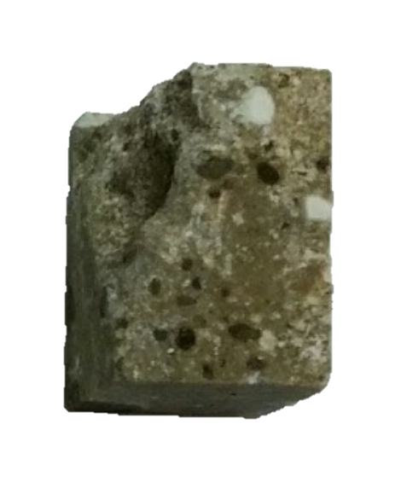
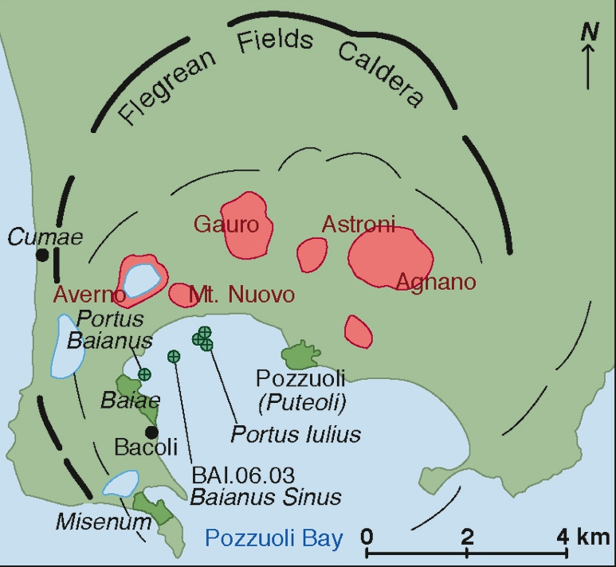
Concrete from Harbors
Specimens: ancient Roman concrete seawater structures from Pozzuoli bay;
Composition: volcanic ash, lime, seawater, and volcanic rocks;
65BC samples: originally ~0.85 m below the surface of the breakwater;
Now: 3.45 m below sea level.
Jackson et al., American Mineralogist, Volume 98, pages 1669–1687, 2013

Slide 11
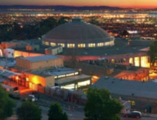
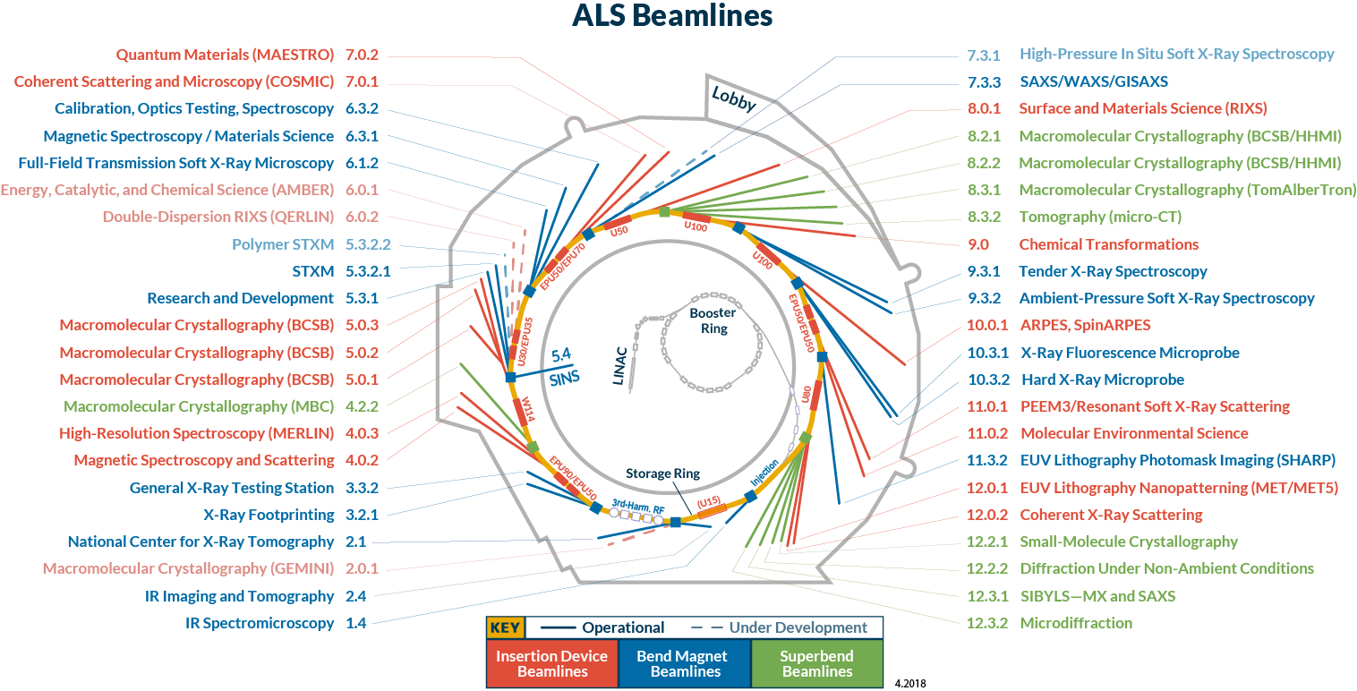
X-Ray Tomography (XRT)
Notes:
We need a method of data analysis and categorization that can be applied to all beamlines.

Slide 12
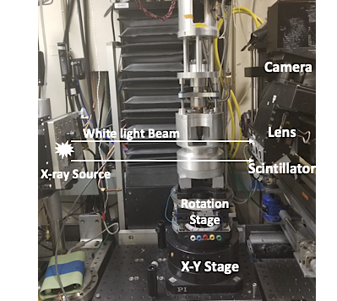
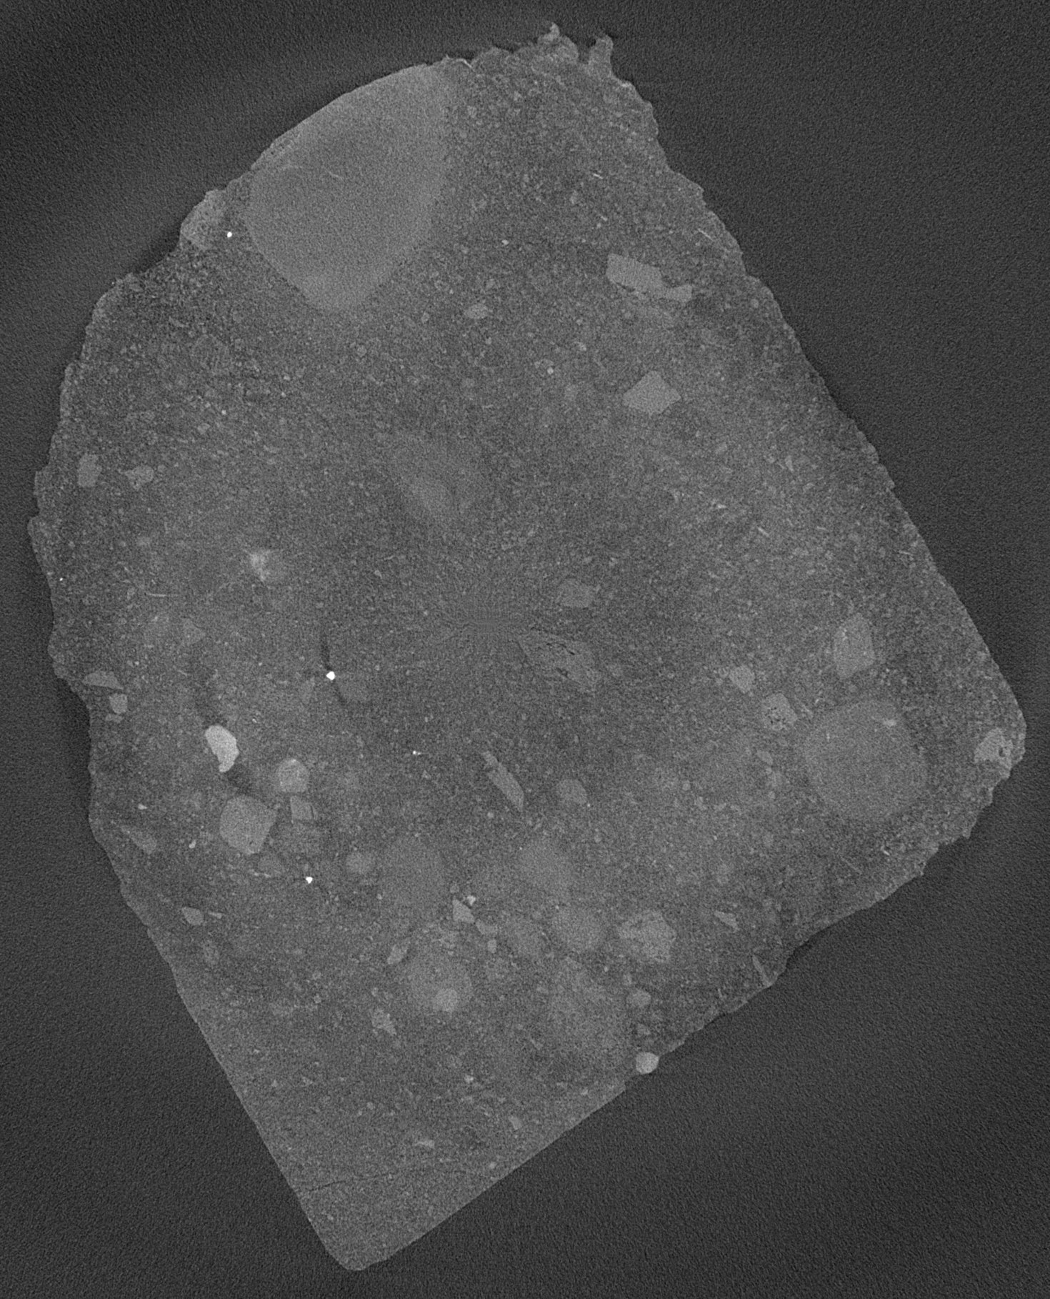
Data acquisition
A
B
C
20mm

Slide 13
Computer Vision Flowchart :
Slicing &
3D rendering
Binarization &
MaxProjection
Masking
Superpixel
Phase segmentation
Segmentation
auditing
Metrology
Enhancement
Vesselness & Texture
Observatory
Discriminatory
Explanatory
Notes:
getFiberROI = edge
getProbFibers = Euclidean distance transform
probeDetails =
AHPCS = allylhydridopolycarbosilane

Slide 14
Superpixel and Simple Linear Iterative Clustering (SLIC)
K = number of superpixels
N = number of image pixels
N/K = ~ size of each superpixels
S = superpixel center at every grid interval
S = sqrt(N/K)
sampling K regularly spaced cluster centers and moving them to seed locations at the lowest gradient position in neighborhood:
Image gradients are computed as:
G(x, y) = ||I(x + 1, y) − I(x − 1, y)||² + ||I(x, y + 1) − I(x, y − 1)||²
Achanta et al, SLIC Superpixels, EPFL Technical Report 2010.
Notes:
A superpixel can be defined as a group of pixels that share common characteristics (like pixel intensity ). Superpixels are becoming useful in many Computer Vision and Image processing algorithms like Image Segmentation, Semantic labeling, Object detection and tracking etc ----They carry more information than pixels.
Superpixels have a perceptual meaning since pixels belonging to a given superpixel share similar visual properties.
They provide a convenient and compact representation of images that can be very useful for computationally demanding problems.
SLIC [1] is a simple and efficient method to decompose an image in visually homogeneous regions. It is based on a spatially localized version of k-means clustering. Similar to mean shift or quick shift (quickshift.h), each pixel is associated to a feature vector

Slide 15
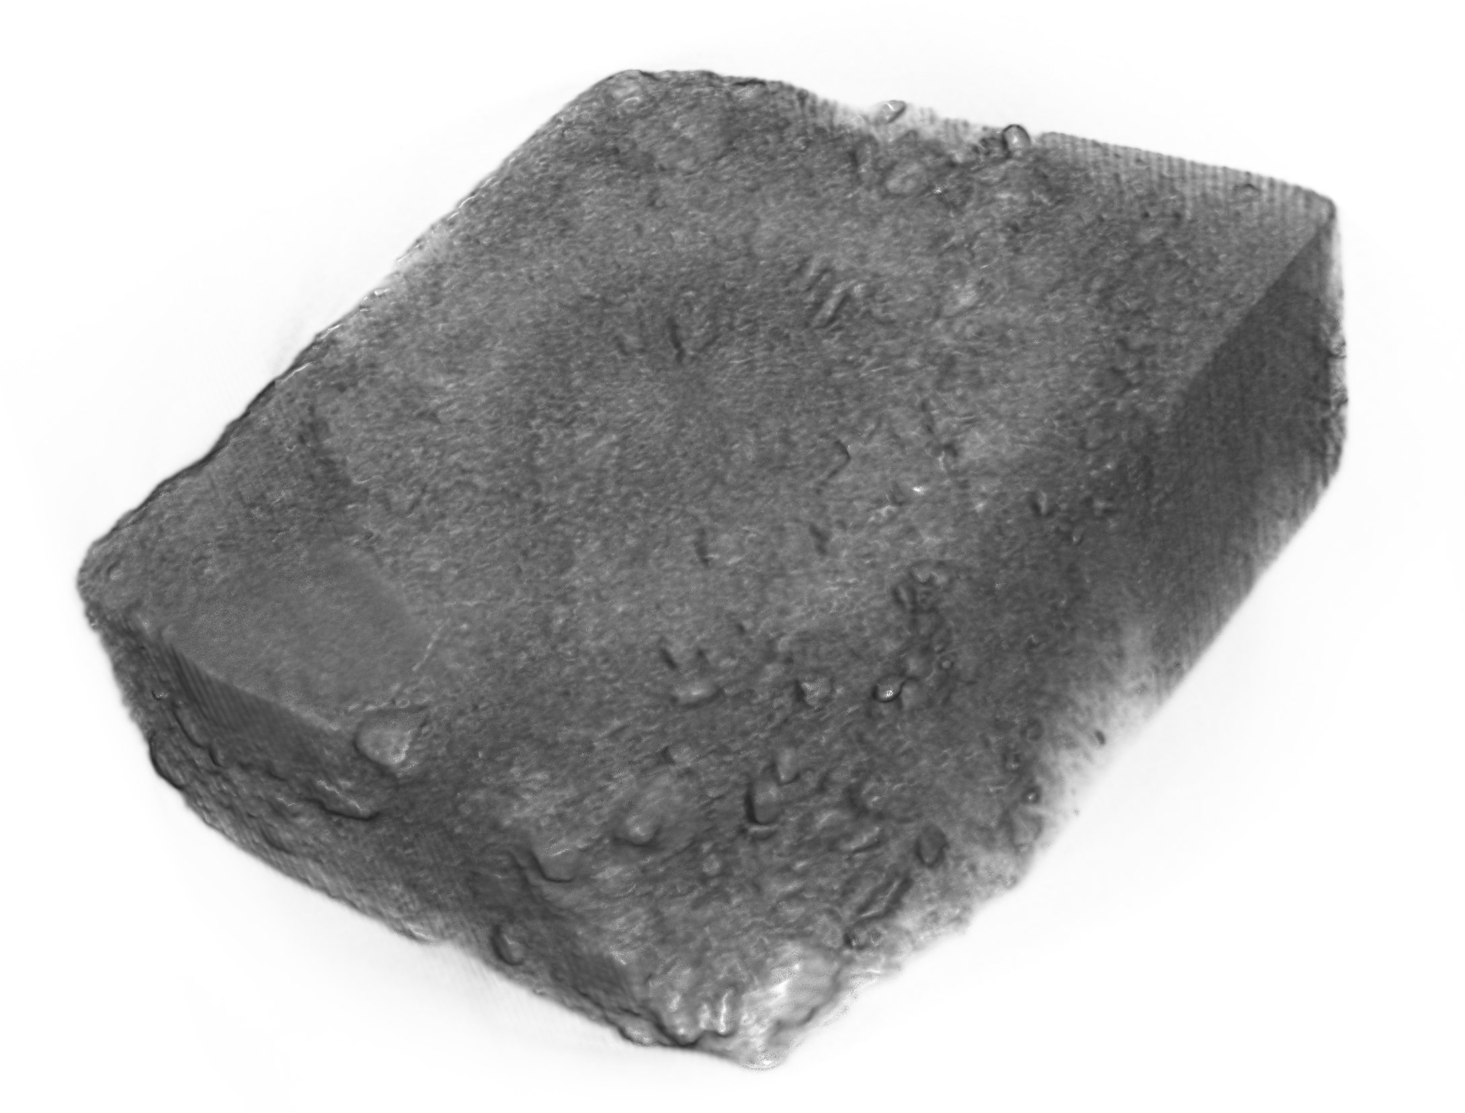
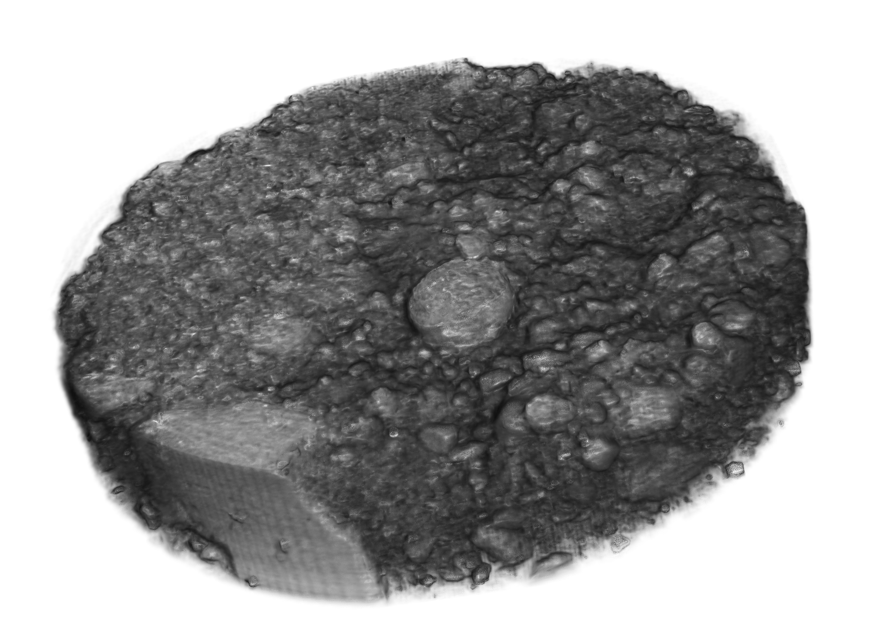
Rendering of XRT from Baiae samples
Ushizima et al, Materials Research Society 2020

Slide 16
Partial volumes after segmentation
Phase segmentation estimates on full stacks
%Volume | Matrix | Aggregate | Pore | Background
S1 | 35.80 | 15.88 | 0.82 | 47.5
S2 | 35.89 | 29.60 | 13.10 | 21.40
Ushizima et al, Materials Research Society 2020

Slide 17
15mm
Notes:
A paper clip is about 40 mm

Slide 18
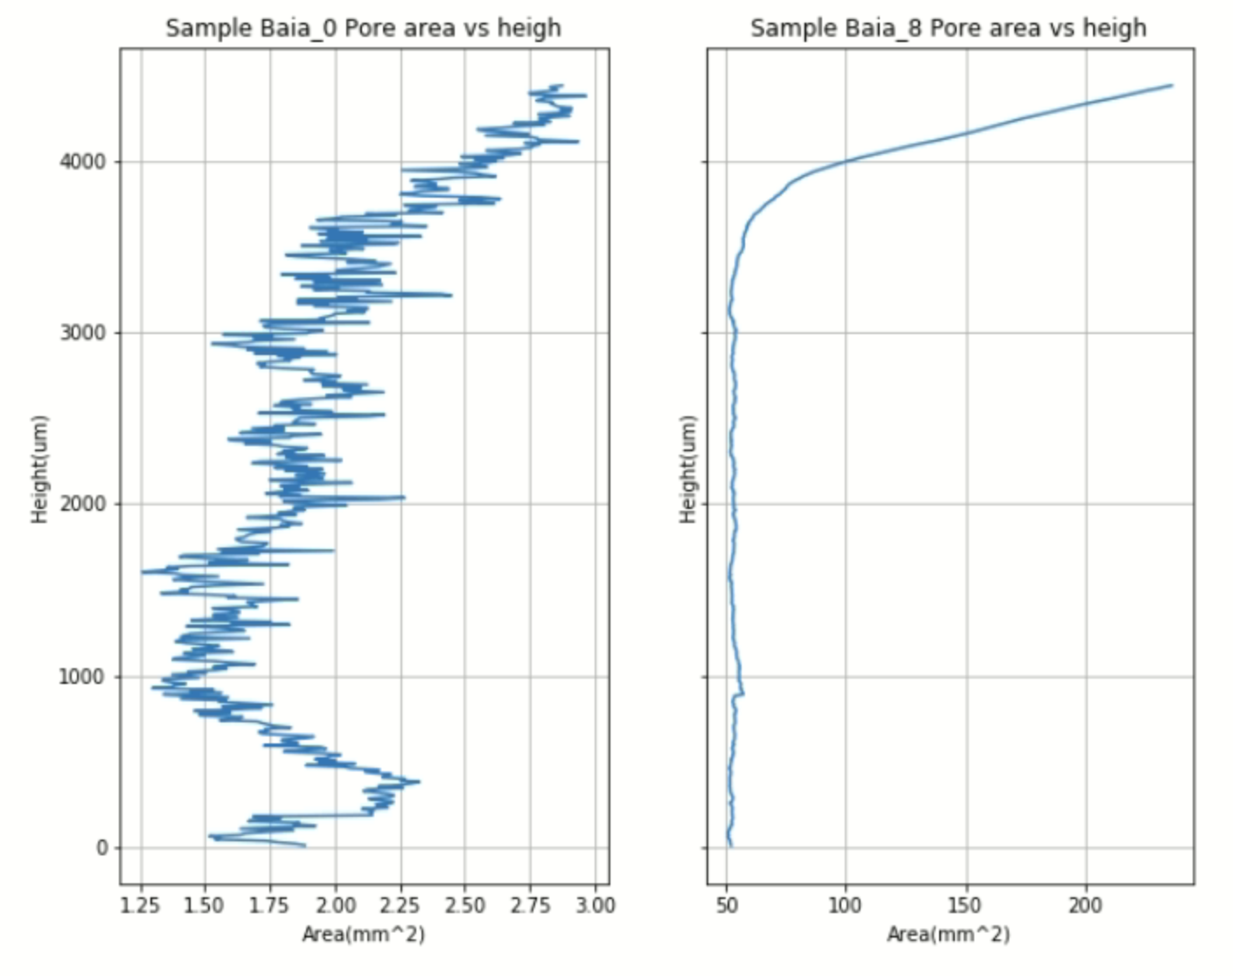
15mm
Notes:
A paper clip is about 40 mm

Slide 19
22mm

Slide 20
22mm

Slide 21
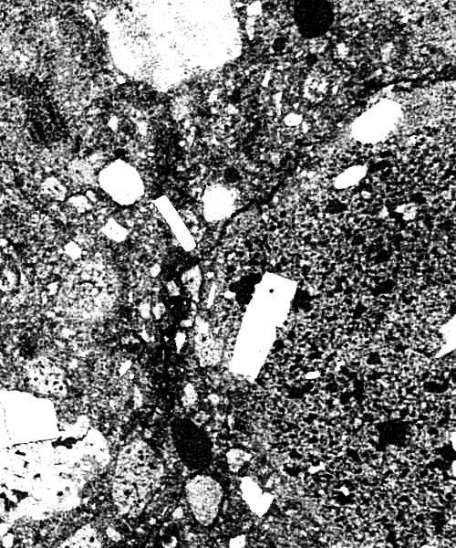
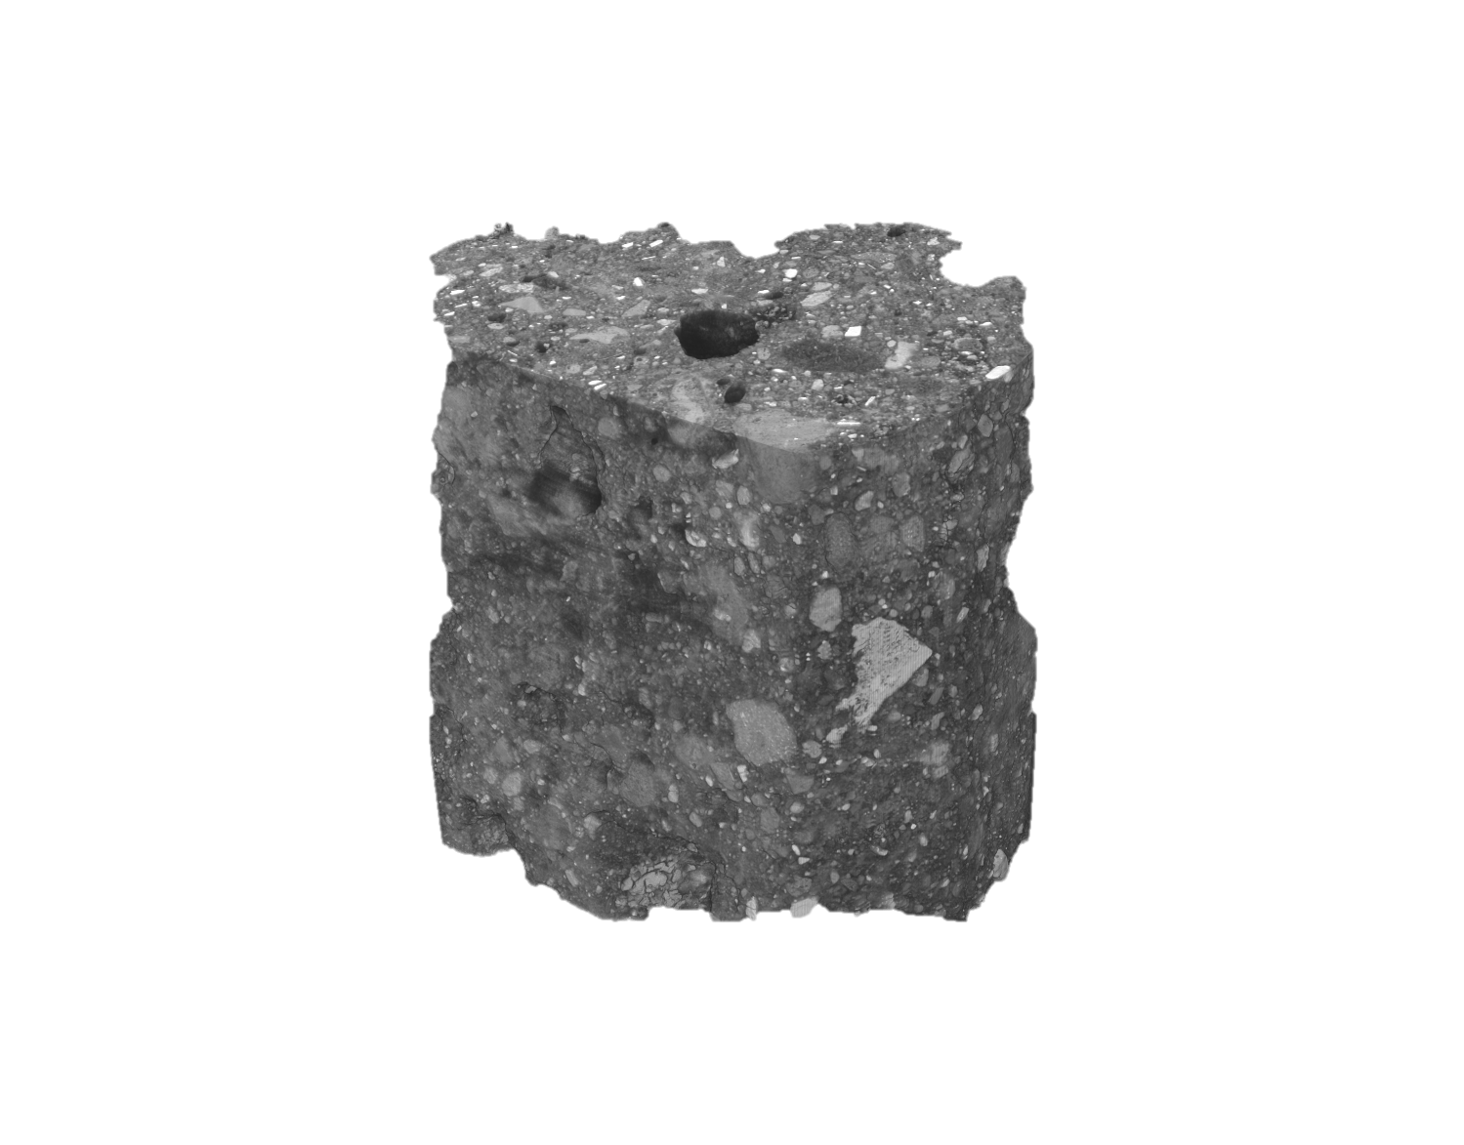
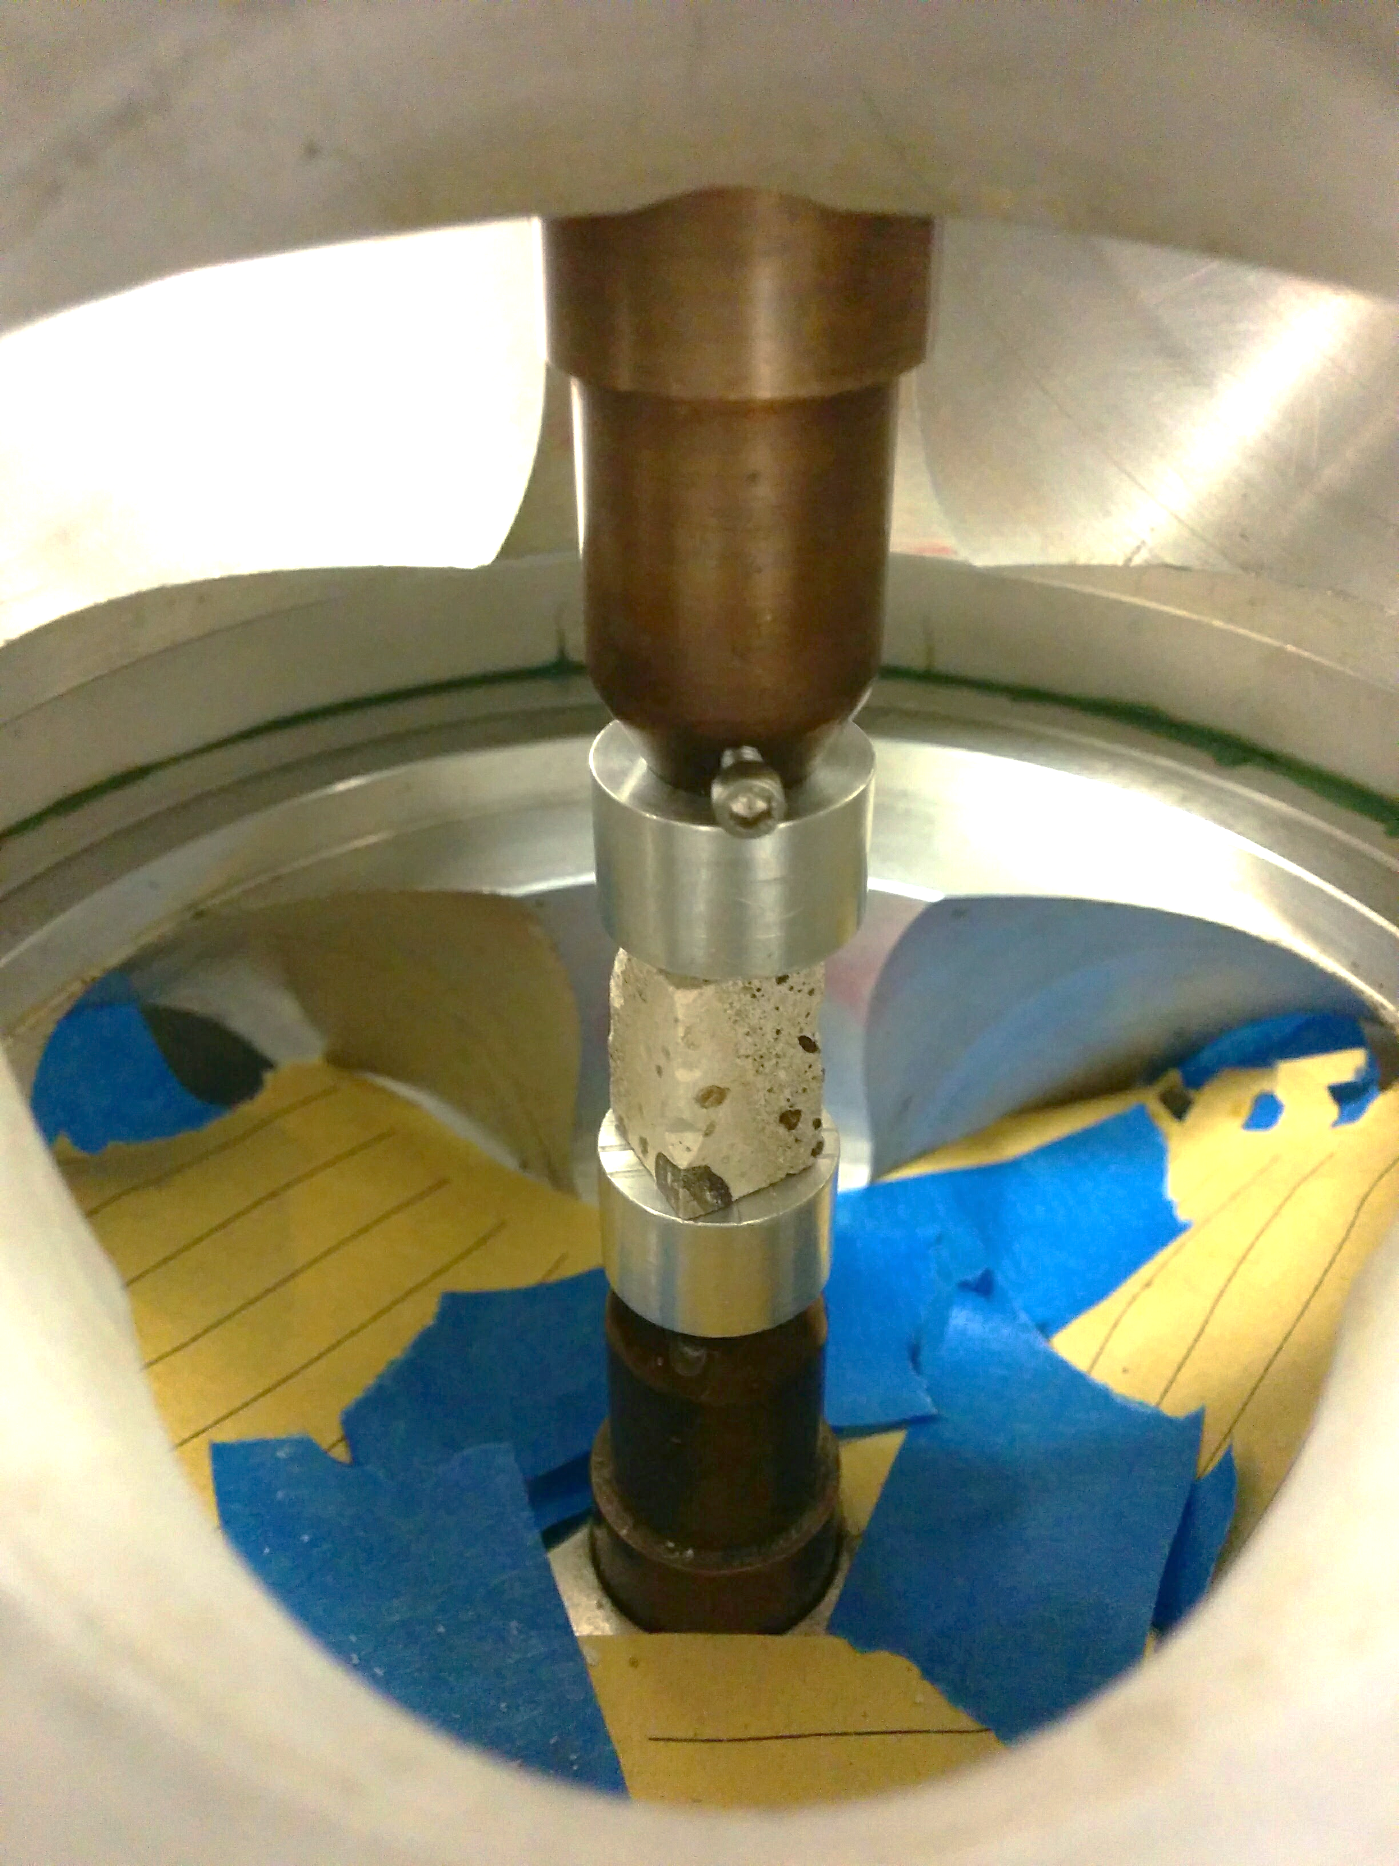
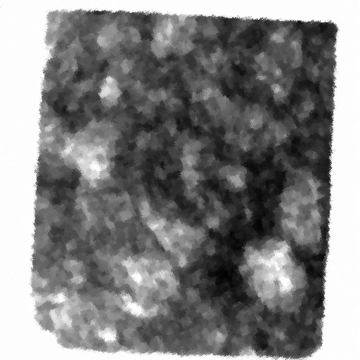
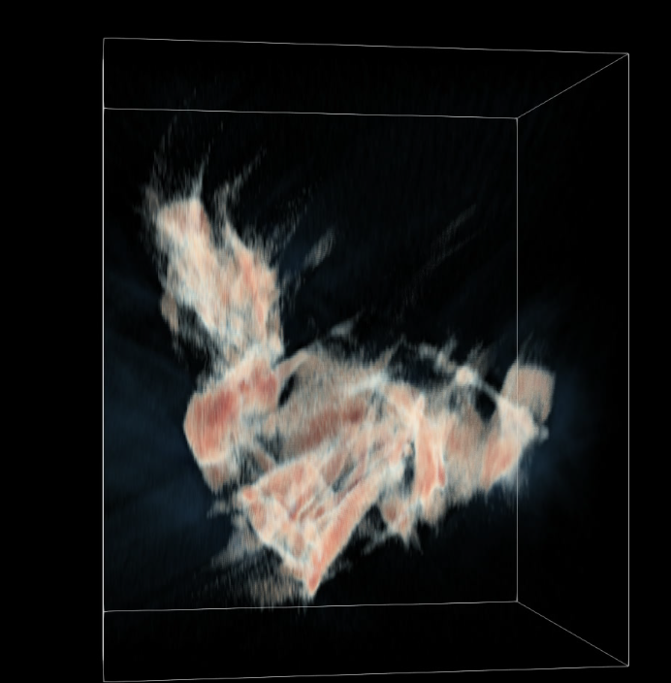
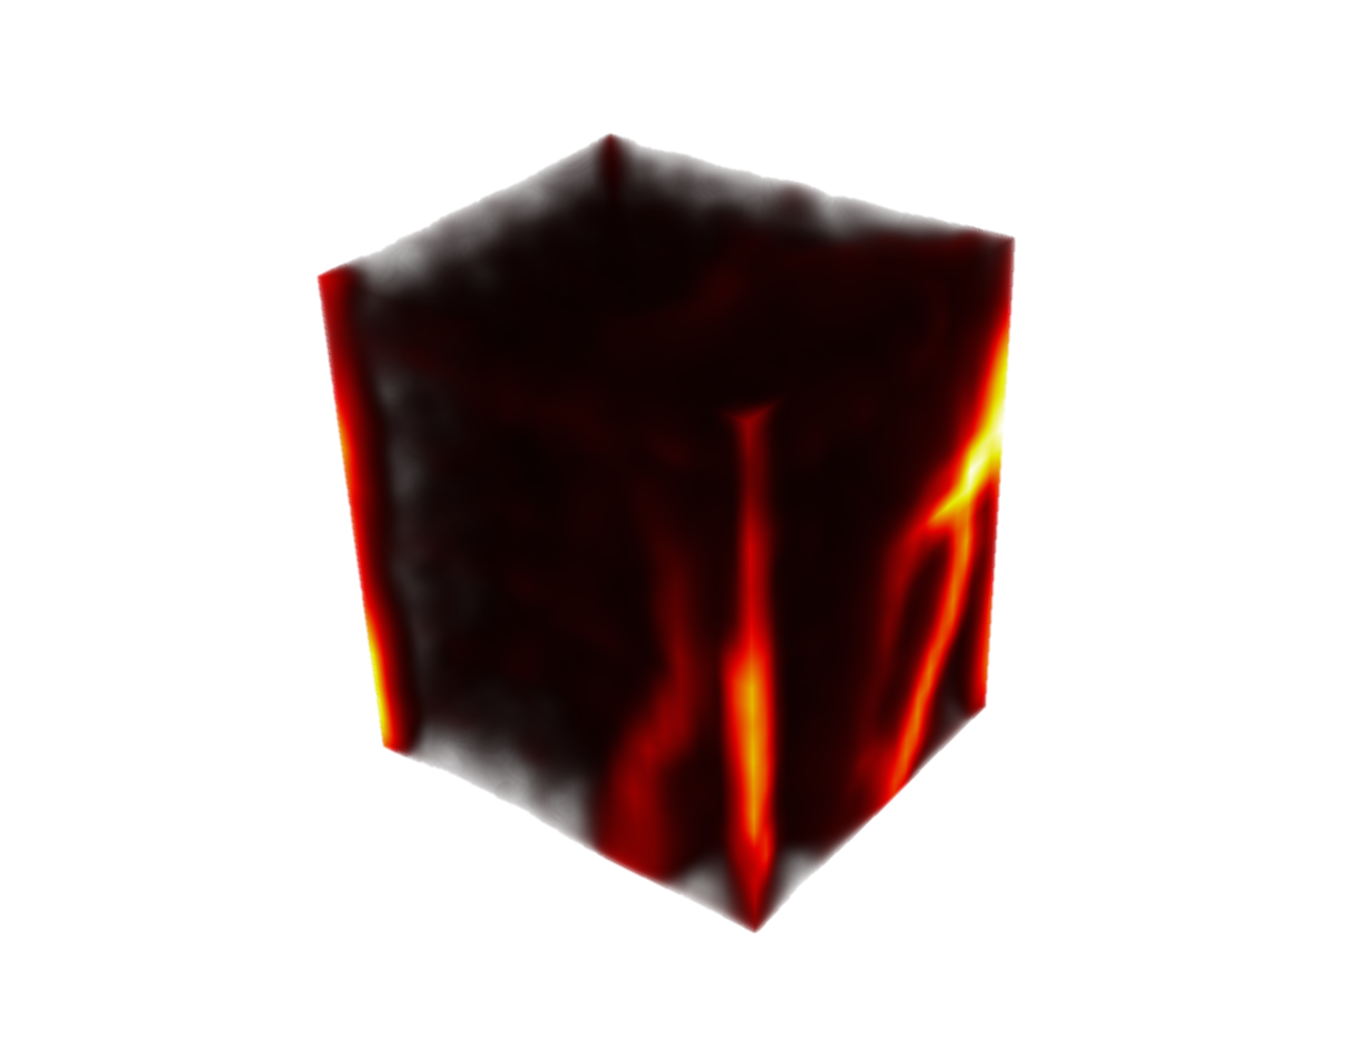
Concrete Imaging from Nanoscale to Microscale
Goal: mechanical resilience and cementitious processes in Ancient Roman architectural mortar – why it outperforms modern concrete?
Multimodal Data Analysis and Synthesis through Math and ML
CSH
growth
Concrete
dynamics
Water
absorption
DVC
Structure from
in-situ analysis
Hard X-ray
tomography
Neutron
radiography
STEM
tomography
Notes:
Overall goal – better concrete! Entire cities around Pompeii, Italy, are still holding up while our bridges are crumbling and need major repairs every 50 years
Warning: Do not share this as it was not published yet
Multinational Collaboration between USA (LBL ALS, Molecular Foundry, UCB Civil eng, UCB Earth Sciences), Italy (Material Science Dep Univ. Basilicata) and France (Cachan Institute of Technology - Université Paris-Sud) research institutions
Tremsin, Li, Su, Telesca, Marroccoli, de Nigris, Xu, Bouterf, Ushizima, Monteiro, “Neutron measurements of water absorption in cracked and uncracked ancient concrete from Pompeii”, in preparation 2019.
Calcium silicate hydrate (or C-S-H)
This research promises to make us rethink how to choose materials for construction in face of climate change and excess of pollutants – should we address reliance on cement? can we use fly ash and slag in a larger scale? We are investigating structure of materials being used for millenniums as part of deploying new materials

Slide 22
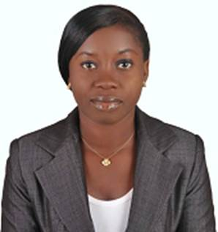

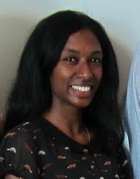
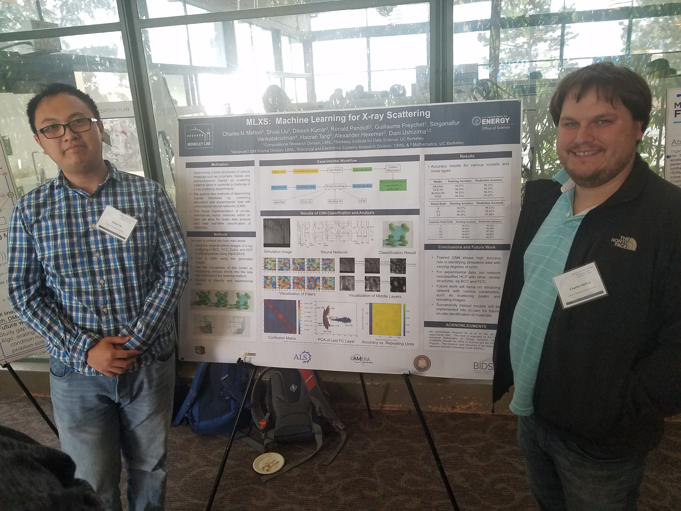


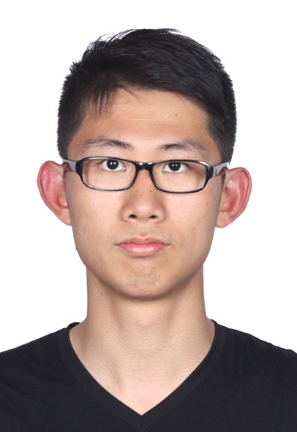
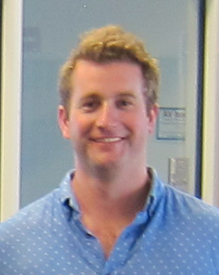

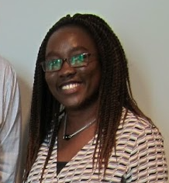


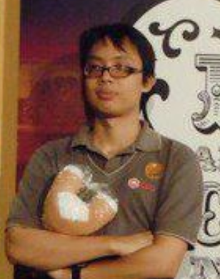

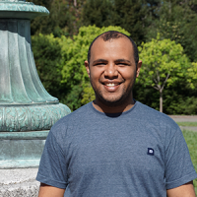
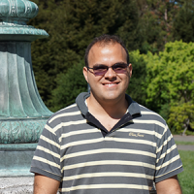
Cultivating next generation of scientists
Research and development through collaboration with and support to the next generation of scientists and engineers around the world
America, Brazil, Cameroon, Canada, China, India, Kenya, Netherlands, Nigeria, South Africa, Thailand, Tunisia, Zimbabwe
Notes:
Ijeoma, Edith, Sam Schickler,

Slide 23



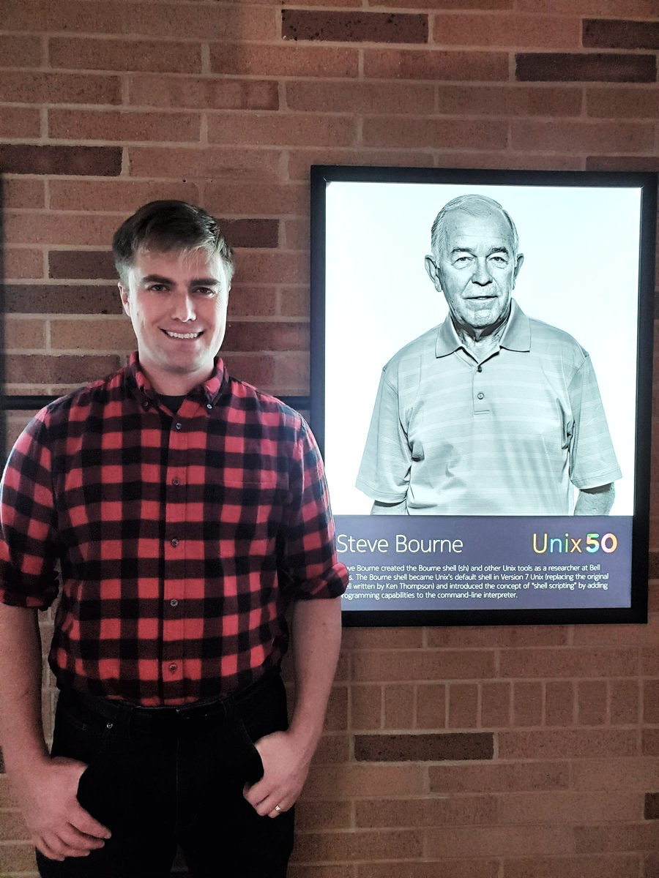

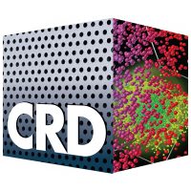
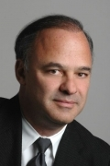


Acknowledgements
http://bit.ly/dxc2020
Thank you
Dani Ushizima
Matt McCormick
Prof. Paulo Monteiro
Dula Parkinson
Ke Xu PhD student

Slide 24

Sustainability
Goal:
Eliminate 1.5 billion metric tons of CO₂
Challenge:
More than1.5 billion metric tons of alternative material
Supply:
- 607-670 million tons of fly ash
- 220 million tons of slag
Courtesy: prof. Paulo Monteiro
Notes:
This research promises to make us rethink how to choose materials for construction in face of climate change and excess of pollutants – can we use fly ash and slag in a larger scale? We are investigating structure of materials being used for millenniums as part of deploying new materials

